Slide 1
Zebrafish Analysis
Project Steps Breakdown

Slide 2
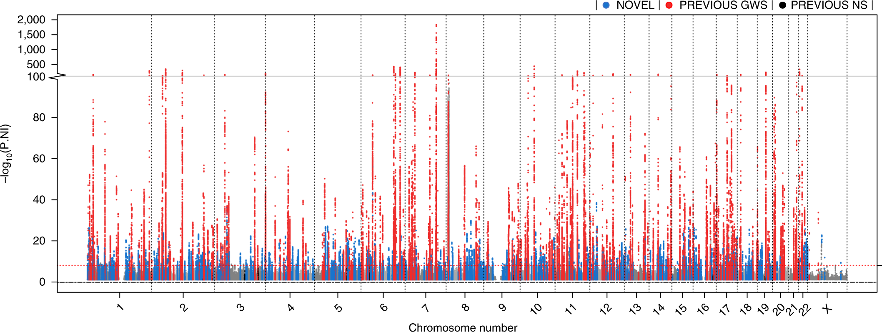
Genetic Associations of Osteoporosis
(Morris, Kemp and Youlten, 2018)
Notes:
Studies have identified over 500 genetic loci to be associated with osteoporosis. This is the particular skeletal condition that Dr. Kague is most interested in.
To visualize this, each red dot here represents regions in the human genome that have been linked to osteoporosis.
Association does not mean causality and functional studies are needed to identify genes responsible for causing particular skeletal conditions.
By identifying causal genes, research communities aim to find therapeutical targets for such diseases. Given the high number of genes that need to be functionally tested, there is a necessity of faster screening systems to benefit rapid genetic discoveries.

Slide 3
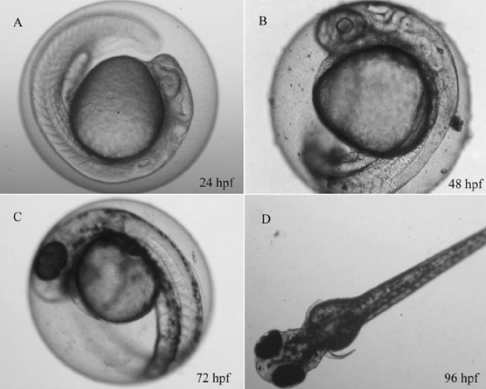
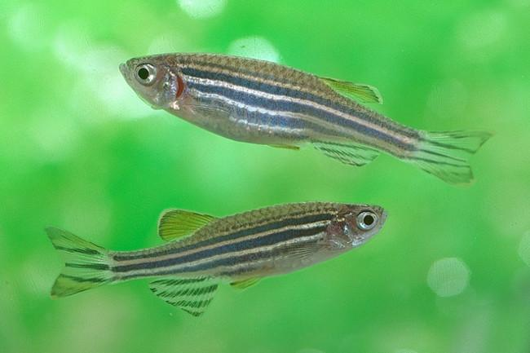
Zebrafish as Animal Models
(Preston, 2014)
(Schiwy, Bräunig and Alert, 2014)
Notes:
Dr. Kague already uses zebrafish in order to accelerate the functional screening of skeletal conditions for humans.
Zebrafish have the same bone cell types as us and have the potential to develop similar degenerative bone conditions.
They also have a much faster growth rate, as seen in the figure illustrating their growth over 96 hours post fertilization.

Slide 4
Aim
To automate the analysis of zebrafish X-rays to allow for in vivo rapid screening of zebrafish carrying mutations in putative candidate genes in skeletal conditions.
Notes:
So the aim of the project was to develop a framework to allow for rapid and robust assessments of the zebrafish skeleton using X-rays of live, genetically-mutated zebrafish.
In particular, Dr. Kague specifically wanted an automatic framework that could quantify:
- The length and curvature of the spine.
- As well as The length and area of specific vertebrae within the spine
A fully automatic framework designed specifically for the analysis of the vertebral column of zebrafish had never been accomplished before this study.
As a result, the background research was mainly based on segmentation publications and subsequent analysis in humans.
The methods outlined in this study were completely novel as they integrated the automatic analysis of genetically-mutated zebrafish using AI

Slide 5
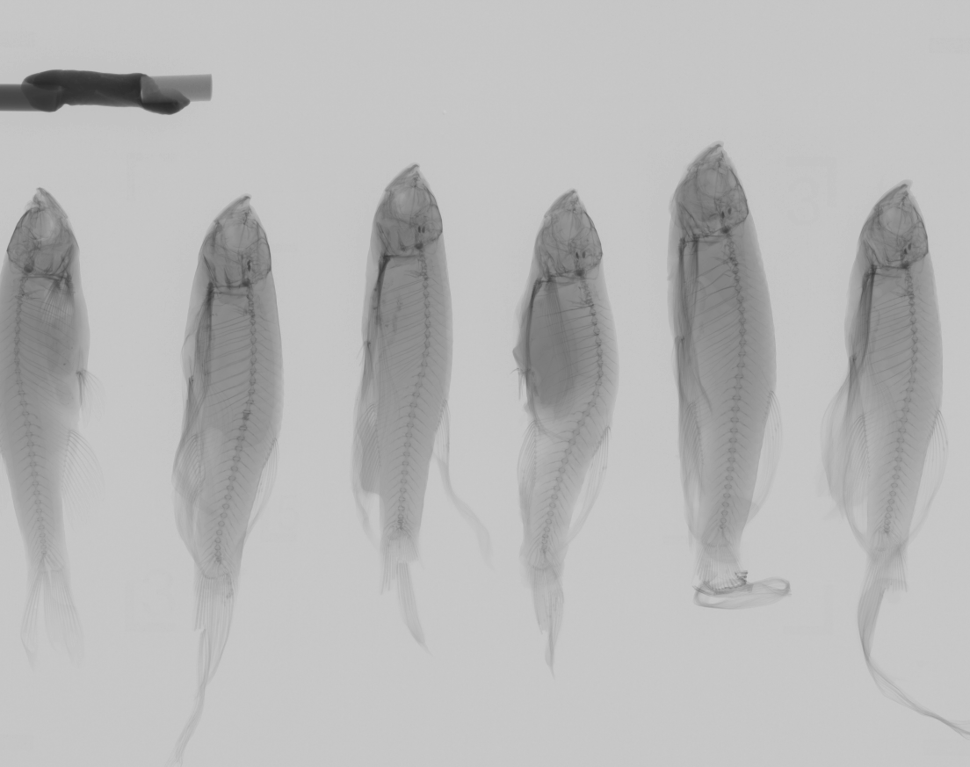
Supplied X-Ray Samples
Contains Multiple Bodies
Calcium Hydroxyapatite Sample (CaHA)
Multiple Zebrafish Samples (~5)
First fish always the same (Wildtype)
Isolate samples for analysis
Isolate CaHA for BMD calibration

Slide 6
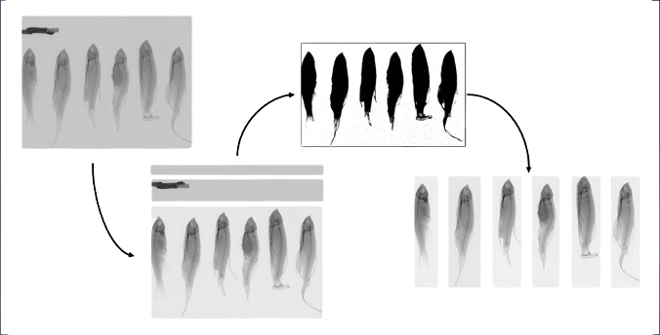
Isolating Zebrafish Samples (semi-auto)

Slide 7
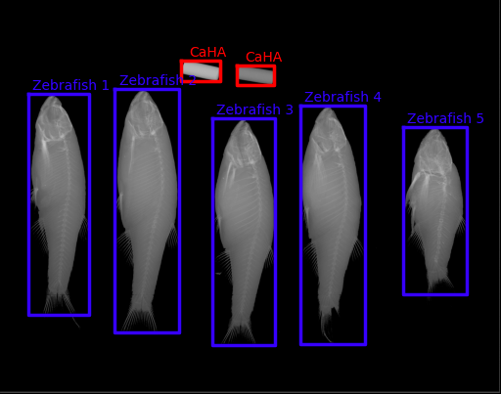
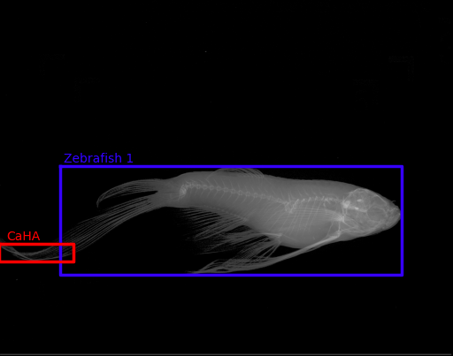
Isolating Zebrafish Samples (semi-auto)

Slide 8
Isolating Zebrafish Samples (deep-learning)
YOLO?

Slide 9
Isolating Spine Region (semi-auto)
Template Matching Method
MATLAB Segment Editor

Slide 10
Isolating Spine Region (deep learning)
Data Breakdown

Slide 11
Isolating Spine Region (deep learning)
Pipeline Outline

Slide 12
Isolating Spine Region (deep learning)
Pipeline Results

Slide 13
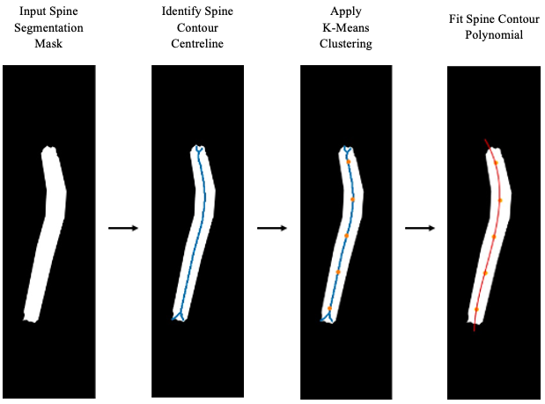
Measuring Spine Length

Slide 14
Measuring Spine Curvature

Slide 15
Isolating Vertebra Region (Manual)
Template Matching Method

Slide 16
Isolating Vertebra Region (deep learning)
Data Breakdown

Slide 17
Isolating Vertebra Region (deep learning)
Pipeline Outline

Slide 18
Isolating Vertebra Region (deep learning)
Pipeline Results

Slide 19
Measuring Vertebra Length

Slide 20
Measuring Vertebra Area

